Slide 1
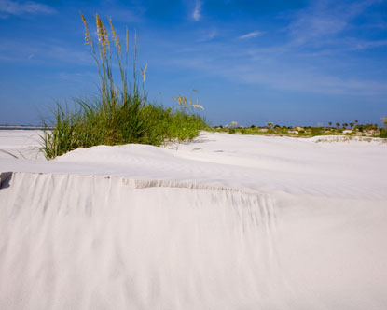
Little Talbot Island
Why should this barrier island remain federal protection?

Slide 2
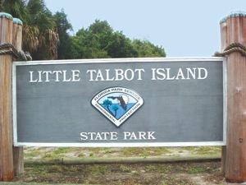
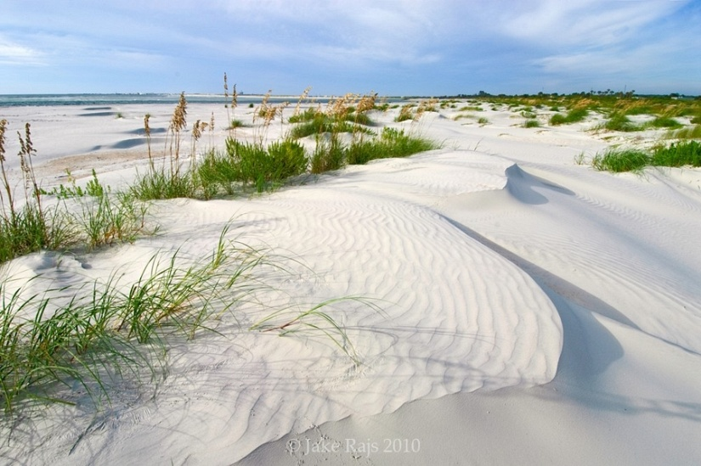
Coastal Barrier Island Act
The act restricts certain Federal expenditures and financial assistance which have the effect of encouraging development of coastal barriers, establishes the John H. Chafee Coastal Barrier Resource System, and calls for consideration of the means and measures for long-term conservation of fish, wildlife, and other natural resources.
Under the CBRA, coastal barriers are defined as bay barriers, barrier islands, and other geological features composed of sediment that protect landward aquatic habitats from direct wind and waves. They provide essential habitats for wildlife and marine life, natural storm buffer zones, and areas of scientific, recreational, historic, and archaeological significance.
Basically: There are little or no federal resources to support any new development or if damage occurs to existing structures. Therefore it would not be wise to invest in an area in which their is no capital or government support those investments.

Slide 3
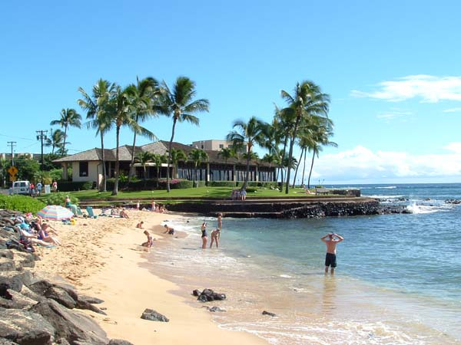
2011 Housing Market
Spring 2011 Market Update
If you can qualify, now is an exceptional time to buy a home in Atlantic Beach. Low rates with falling home prices makes a home purchase a great value!
Average Home Price $800,000 - View Graph Trend
Average Price Compared to Last Year Up 5-10%
Average Time on Market More than 120 days
Best Selling Price Range $250,000 - $299,000
Worst Selling Price Range $1,000,000+
Prices As % of Asking Price 90-95%
Existing Home Prices for the past 90 days are? Increasing
Market Trend Decreasing
Buyers’ or Sellers’ Market More sellers than buyers
Buyer Activity for the past 90 days in Atlantic Beach is Increasing
Seller Activity for the past 90 days in Atlantic Beach is? Decreasing
Multiple Offers? Yes
What Percentage of the Current Housing Inventory are Foreclosures and/or Short Sales? 25-30%
Is Financing Available For Qualified Buyers? Yes
Housing Inventory Good supply - Some Prices
Inventory Comments Now is an excellent time to buy in Atlantic beach. Inventory is priced from $72,000 to just under $5,000,000 with fewer properties on the market than last year. the lifestlye offered in this beach community is affordable again!
Greatest Activity Repeat Buyers
Reason to Buy/Sell Lower prices with good selection and competitive interest rates creates a perfect time to buy in Atlantic Beach!
Nearest Metro Area Jacksonville
Housing Hot Spots Atlantic Beach and Ponte Vedra Beach are always considered
Average Sold Price $800,000 - View Graph Trend

Slide 4
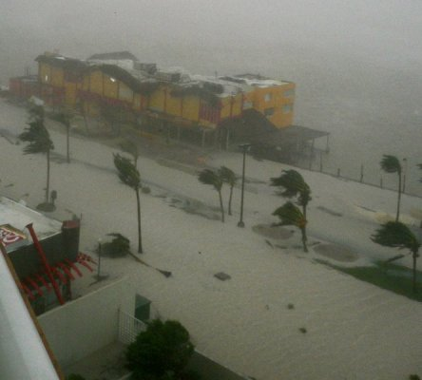
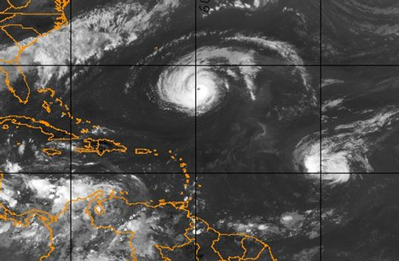
10 to 20 Hurricanes a Year!
Build Here and this could be YOU!

Slide 5
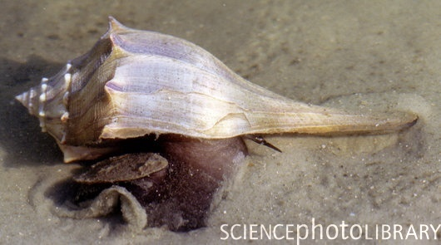
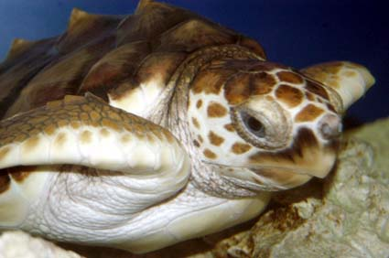
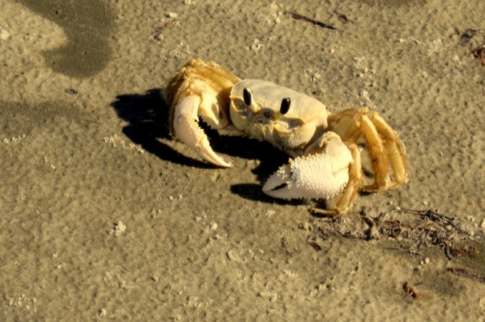
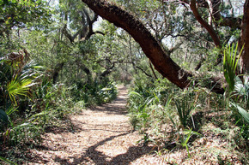
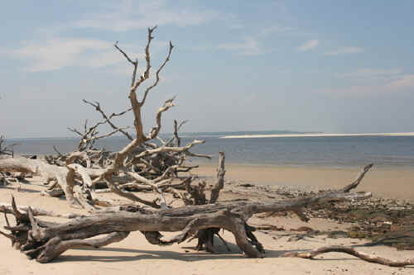
Maintain Florida’s Beauty & Wildlife

